Slide 1
Tbilisi Oncodipensary - Tbilisi Cancer Center

Slide 2
To care for human health
Your health is our success

Slide 3
With the support of Tbilisi Municipality the Oncological Dispensary - Tbilisi Cancer Center was founded in 2003 in order to analyze and improve oncopedemiological condition and execute oncopreventive programs in Georgia. Later its activities have been expanded and started working with full load. Nowadays the center supports not only medical, but research and educational line.

Slide 4
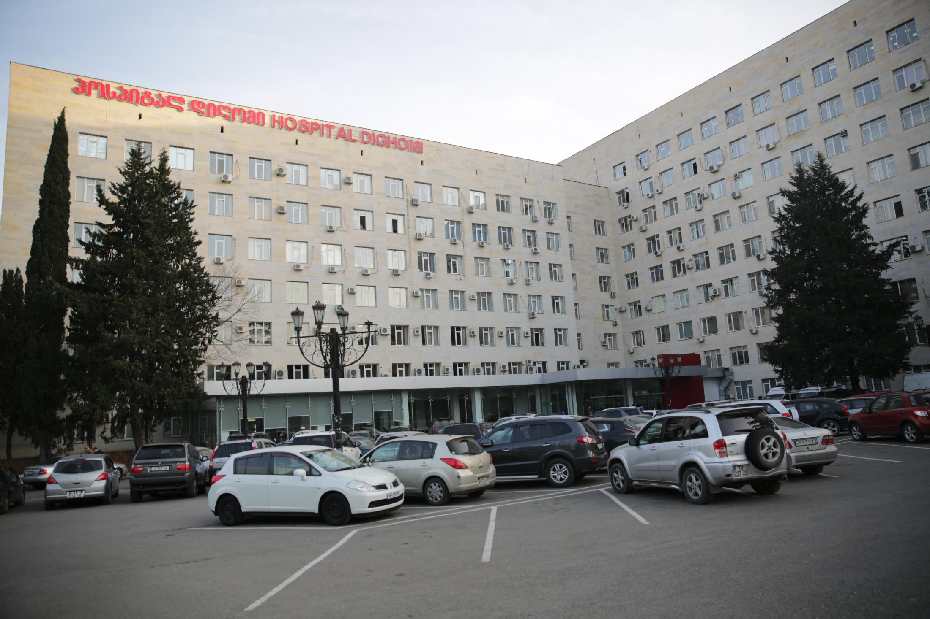
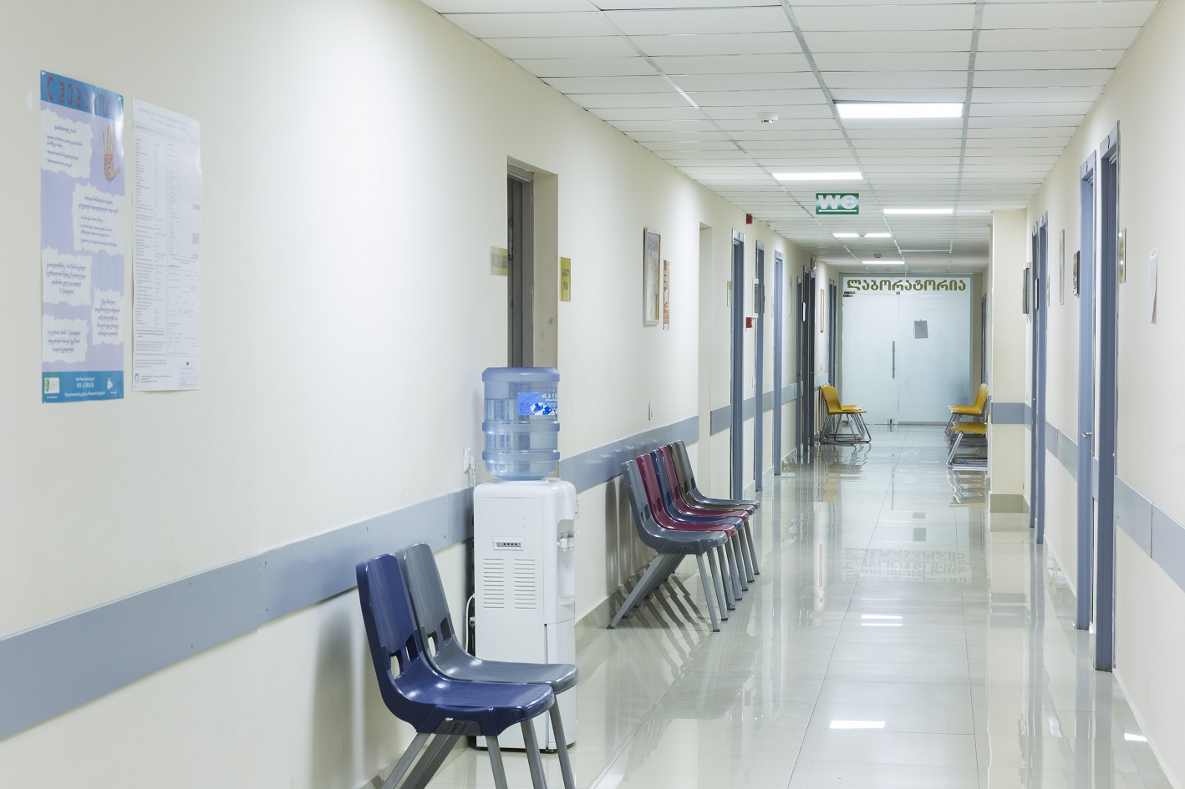

Slide 5
Tbilisi Cancer Center has been working in four main directions:
1) Creation of Tbilisi Population Register;
2) Information-educational activities, including training of district physicians and family doctors;
3) Implementing screening programs;
4) Management of patients with cancer. (Control)

Slide 6
It is recognized worldwide that the effective and cost-effective method of fighting cancer - its early detection and diagnosis.
In 2006, the co-sponsor and co-participant of the program became the United Nations Population Fund (UNFPA) which in 2007 recognized this program as the UN's most successful medical project in the region.
In 2008, Cervical Cancer Prevention Program, which was carried out at the Tbilisi Cancer Center (Oncodispesary), was awarded with the status of the most successful program in the field by the Association of European Onco-Gynecologists.

Slide 7
Activities nowadays
The clinic is located at 1600 square meters with the following departments:
Outpatient Unit. Diagnostic and treatment directions: Cardiology, General medicine, Endocrinology, Allergology, Ophthalmology, Surgery, Skin and soft tissue oncology and head and neck cancer, Otorhinolaryngology, Gynecology, urology, orthopedia, plastic surgery, chemotherapy, mammography, ultrasound, endoscopy, cytology and laboratory.
The Inpatient Unit has two surgery department with 25 and 12 beds and 2 operating blocks with three large and one small operating theaters where the various volumes and types of operations are carried out. The clinic has also intensive therapy unit.

Slide 8
Activities nowadays
The clinic produces 8000-10000 diagnostic and treating procedures per year. There are also 1300-1600 different types and volumes as oncological and non-oncological operations done in our hospital. The clinic serves patients from Georgia as well as neighboring countries - Armenia, Azerbaijan, Russia, Europe and Asia. We cooperate with both state and private insurance companies. The clinic regularly participates in state and other private oncopreventive programs such as "EuroMelanoma", examination of citizens for early detection of oncological diseases and other activities.

Slide 9
Innovations and modern technologies
Intraoperative radiation therapy (IORT and LIAC) of oncologic patients with modern German and Italian medical devices has been introduced in our clinic for the first time in the region. We have also successfully started using the concept of detecting Sentinel lymph nodes in the treatment of mammological patients.

Slide 11
Academic research and educational activities:
Our hospital is the educational and studding base of many head medical universities and medical institutions of Georgia, where the students pre-diploma and post-graduate training activities are conducted.
We have regular contacts with Tbilisi and the regional oncologists and other professionals who regularly receive information about the preventive diagnostic and medical activities in the clinic.
Our clinic is successfully equipped with a training center where the regular medical training on specific medical methods is conducted for the future medical staff.
The Department of Scientific and Clinical Studies actively participates in both regional and international research and scientific projects. Different clinical trials are underway in this department.
Within the framework of oncological awareness, the population is constantly being informed by all media outlets; Media, social media, printed booklets, meetings on the essence and effectiveness of the prevention, early diagnostics and treatment of oncological diseases.

Slide 13
Development and future
Expansion of laparoscopic direction with small invasive procedures and operations, including oncologic pathologies.
Implementation of conception of the Sentinel lymph nodes detection in skin tumors and oncoginecologic and oncourologic pathologies management.
To develop and implement new innovations and modern medical technologies.

