Slide 1
PREECLAMPSIA COMPLICANZE MATERNE
Lorella Battini MD, MA
UO Ostetricia e Ginecologia 2, ( Direttore Dr P. Bottone ) AOUP
OGASH-IAMSS
OGASH
AOGOI Toscana, Congresso Regionale Hotel Londra, Firenze 21/10/2021
Notes:
La Placenta …come il Mare : Elemento Vitale …ma anche potenzialmente Fatale per il Bambino e per sua Madre

Slide 2
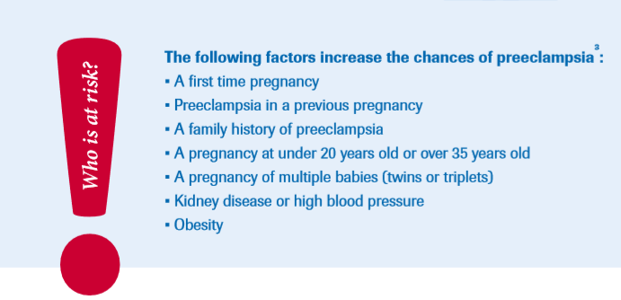
Preeclampsia/ EPHGestosis/ Rippmann Syndrome ( OG )
Millions of Dreams every year are broken by PE
RISK FACTORS
Diagnosis:BP/uP/E standard of care affected by poor accuracy
15%Preterm Birth
8,5 millions women/year globally
42% of Maternal Death worldwide
.Preexisting Diabetes
.Donor Oocyte Pregnancy
.Antiphosfolipid Antibodies
No financial relationships to disclose
Notes:
Factors reported to be associated with increased risk of preeclampsia include a history of preeclampsia, family history of hypertensive disorders in pregnancy, the presence of antiphospholipid antibodies, nulliparity, multiple pregnancy, donor oocyte pregnancy, advanced maternal age and pre-existing diabetes, renal disease, high blood pressure and/or high body mass index.

Slide 3
PATHOPHYSIOLOGY
Preeclampsia is a disorder of widespread vascular endothelial disfunction and vasospasm that clinically occurs after 20 weeks' gestation and can present as late as 4-6 weeks post partum.
The syndrome quickly disappears at pregnancy interruption, as the fetal-placental unit could be the target of a maternal rejective reaction
Notes:
The placenta acts as an immunological barrier between the mother and the fetal “graft”, allowing two antigenically different organisms to tolerate one another. The syndrome quickly disappears at pregnancy interruption, as the fetus could be the target of a maternal rejective reaction. Moving from a rejection hypothesis of the fetal graft occurring in gestosis, we undertook these studies to evaluate at placental, plasmatic and DNA molecular level, the potential ethiopatogenetical role of the MHC-HLA antigens, which are implicated in self and non self recognition and in rejective reactions.

Slide 4
Clin Exp Obst Gyn., 21, 228-230, 1994.
Gestosis and fetal rejection: immunopathogenetic role of HLA-DR
de Luca Brunori I., Battini L., Simonelli M. et al.

Slide 5
J. Anat. Embriol., 103, 202, 1998
Ultrastructural study of the human placental endothelium in preeclampsia
de Luca Brunori I., Battini L., Lenzi P., Paparelli A. et Al.

Slide 6
Hum.Reprod. 15, 1807-1812, 2000.
Increased HLA-DR homozygosity associated with preeclampsia
de Luca Brunori, I., Battini, M. Simonelli et al.

Slide 7
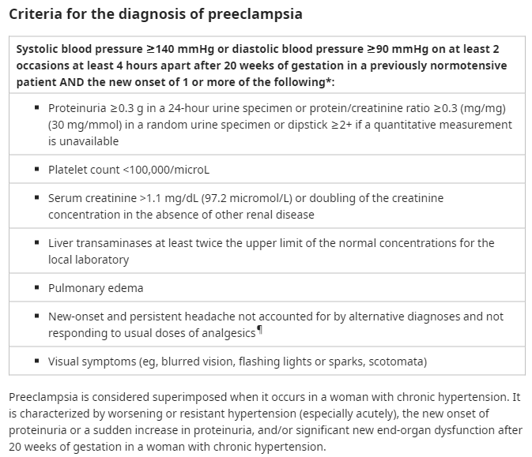
ACOG Pract.Bull 2020, 135;e237

Slide 8
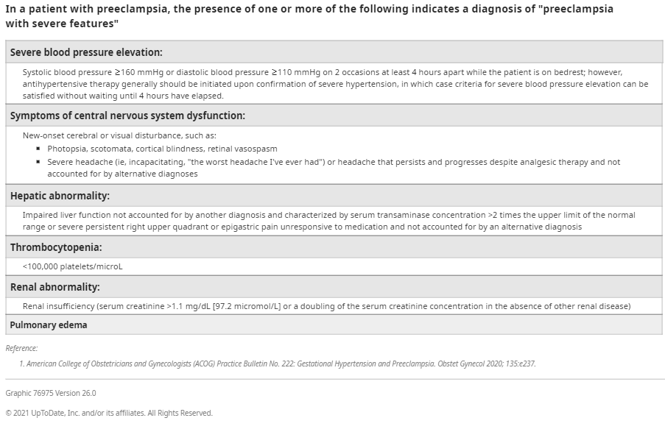

Slide 9
PREECLAMPSIA ITSELF
IS
A MAJOR COMPLICATION OF PREGNANCY
!

Slide 10
PREECLAMPSIA: MATERNAL COMPLICATIONS
ACUTE COMPLICATIONS
LONG TERM COMPLICATIONS

Slide 11
ACUTE COMPLICATIONS
ECLAMPSIA
HELLP SYNDROME
LIVER RUPTURE
PULMONARY EDEMA
RENAL FAILURE
DIC
HYPERTENSIVE EMERGENCY: stroke, retinal detachment
HYPERTENSIVE ENCEPHALOPATY and CORTICAL BLINDNESS
PLACENTAL ABRUPTIO or PARTIAL DETACHMENT
MYOCARDIAL INFARCTION/CARDIOMYOPATHY
DEATH
Notes:
Si abbattono come la Grande Onda di Kanagawa a complicare ulteriormente la Preeclampsia

Slide 12
What to do ?
Most patients with preeclampsia with severe features are delivered promptly to prevent maternal and fetal complications.
Since the disease is progressive and no medical treatment to prevent progression exists (other than magnesium sulfate to prevent eclampsia), DELIVERY IS ALWAYS IN THE MOTHER'S BEST INTEREST.
However, because preterm delivery may not be in the newborn's best interest, delaying delivery
to increase fetal maturity and thereby reduce neonatal morbidity and mortality “can be considered under certain circumstances”

Slide 13
expectant management
Maternal Side: In studies of preeclampsia with severe features with onset in the second trimester,
25 to 63% of patients developed serious complications, including HELLP syndrome (hemolysis, elevated liver enzymes, low platelets), renal insufficiency, placental abruption, pulmonary edema, and eclampsia
Fetal – Serious fetal complications of preeclampsia with severe features include growth restriction and death. The frequency of these complications depends, in part, on the gestational age at onset: Early onset (variably defined as either second trimester or <34 weeks of gestation) has a poorer prognosis than Late onset (variably defined as either third trimester or ≥34 weeks of gestation).
Perinatal mortality – Studies of expectant management of preeclampsia with severe features with onset in the second trimester describe high perinatal mortality (PNM) [7,10]: 40-98% in inverse proportion to gestational age
PNM varies among hospitals and is impacted by factors other than gestational age, such as sex, birth weight, and receipt of antenatal corticosteroids, and these factors should be considered when counseling individual patients

Slide 14
RISK of EXPECTANT MANAGEMENT
The worsening maternal endothelial dysfunction and continued poor perfusion of major maternal organs have the potential for severe end-organ damage to the brain, liver, kidneys, hematologic and vascular systems, and placenta.
Fetal risks include progressive growth restriction and demise from placental abruption or uteroplacental insufficiency.
Therefore, when the clinician and patient choose expectant management, the specific circumstances prompting this awaiting approach rather than prompt delivery should be clearly documented and the decision revisited at regular intervals

Slide 15
Delivery Timing
( AIPE Recomendations 2020)
a. PE Onset > 37 w ----------→Delivery Planning
b. PE Onset 34-37 w: Wait and see till to Delivery Planning at 37 w
c. PE Onset < 34 w : Address Pt to 3° Level Center for Delivery Planning at 37 w
d. PE Onset before Fetal viability, < 23 w: careful couselling with Mother to inform about possibility of very preterm delivery, before fetal viability, to avoid maternal life threatening conditions or major morbidity complications
Prompt delivery in case of:
Refractory Maternal Hypertension despite 3 or more classes of antihiypertensive drugs at appropriate posology
Progressive deterioration of liver or kidney function, evidence of haemolysis or significant decrease in platelet count.
Ongoing neurological changes such as severe intractable headache, repeated visual scotomas or eclampsia
Distacco intempestivo di placenta
Pulmonary edema and / or maternal pulsed oximetry demonstrating a SatO2 <90%.
Fetal growth restriction with impaired Doppler velocimetry, STV on c-CTG or CTG:
Notes:
Si dovrebbe pianificare il parto sulla base dell’epoca gestazionale e delle condizioni materno-fetali secondo il seguente schema
L’acido urico sierico e l’entità della proteinuria non vanno considerati come indicazione per la pianificazione del parto.
3. In caso di preeclampsia con ipertensione grave (≥160/110 mmHg) e/o se ci sono segni premonitori di eclampsia come cefalea, ripetuti scotomi visivi o clono, sussiste l’indicazione alla somministrazione di solfato di magnesio (bolo di 4 g endovena seguito da un’infusione di mantenimento di 1g/ora fino a 24 ore post-partum).
4. L’ISSHP e l’AIPE non raccomandano alcuna distinzione tra preeclampsia lieve o severa nella pratica clinica. Ogni caso di preeclampsia andrebbe
trattato come una condizione potenzialmente ingravescente, considerando che alcuni studi riportano una mediana di latenza tra diagnosi e parto di 2-4 giorni. La distinzione tra preeclampsia placentare/materna, precoce/tardiva, lieve/severa deve essere considerata solo per motivi di ricerca

Slide 16
Liver Rupture
Liver rupture is one of the most severe consequences of preeclampsia with severe features /HELLP syndrome,
Reported maternal death rate of more than 30%.59 It occurs most commonly in multiparas of advanced age. Fortunately, it is rare.
The precise cause of liver rupture remains unknown.
The prevailing theory is that endothelial dysfunction with intravascular fibrin deposits and hepatic sinusoidal obstruction leads to intrahepatic vascular congestion, increased intrahepatic pressure, and distention of Glisson’s capsule, and finally to the development of a subcapsular hepatic hematoma and liver rupture

Slide 17
LIVER EMATOMA AND /OR RUPTURE:
CLINICAL MANIFESTATIONS AND DIAGNOSIS
High Clinical suspicion is the key to prompt and accurate diagnosis.
Pain in the right upper quadrant and/or epigastric area and focal tenderness.
Bilateral shoulder-tip pain is suggestive of intraabdominal hemorrhage.
Rarely, an abdominal mass may be palpated: if any, avoid further manipulations which may cause the hematoma to rupture.
Imaging techniques: ultrasound, computed tomography (CT), or Magnetic resonance imaging (MRI) may enable early and accurate diagnosis of liver hematoma or rupture
Notes:
are the most important
clinical features, especially if they occur in
the setting of preeclampsia/HELLP syndrome

Slide 18
MANAGEMENT
multidisciplinary approach in a tertiary care facility, if possible.
First priority: to stabilize the maternal
hemodynamic status.
Aggressive blood transfusion may be necessary.
Immediate consultation with a staff anesthesiologist and a general or vascular surgeon is indicated.
If liver hematoma in the antepartum period without evidence of rupture: immediate exploratory laparotomy and cesarean delivery
If there is evidence of liver rupture, prompt surgical intervention under general endotracheal anesthesia is mandated.
Focus on the need for invasive hemodynamic monitoring and on blood product replacement and correction of coagulopathy, if indicated. After delivery of the fetus through a vertical skin incision, the upper abdomen should be explored. Among several approaches to the management of liver rupture , a decision of which approach to take depends on the hemodynamic status of the patient, the extent of the rupture, the magnitude and rate of ongoing hemorrhage, and the experience of the surgeons.
Hepatic artery embolization was reported to have the highest maternal survival rate of around 90% and should be attempted if hemorrhage can be controlled and if the patient is hemodynamically stable.
Notes:
For the nonexpanding
liver hematoma, surgical repair or evacuation
is usually not necessary. Expectant
management with serial CT or abdominal ultrasound examinations may be all that is needed.

Slide 19
PULMONARY EDEMA
0.05 up to 2.9% in PE
70% after delivery 30% before
Worsening dyspnea/orthopnea, auditory signs , Hypoxemia
Diagnosis: EGA/ chest x-ray/Angio CT
DD: pulmonary embolism, pneumonia, cardiomiopathy
Management: LAMNOP
Lasix 20-40 mg/2 min IV, if no response: >40 up to 120mg in 1 h,IV slowly ( K, if needed)
Morphine Sulfate iv : 2up to 5 mg to < adrenergic effect on pulmonary microcirculation
Na+/water restriction & strict in/output monitor
O2 supply 8-10l/min and continuous O2 monitor
Position Elevation of Head/Chest to improve ventilation by<pulmonary capillary wedge pres
Beta blockade if needed, in congestive heartfailure

Slide 20
Renal Failure
OVERVIEW
abrupt reduction in the maternal glomerular filtration rate: endotheliosis and vasoconstriction
18% of all cases of acute renal failure were of obstetric origin and 20.9 out of these, post PE
PE Tubular Necrosis : generally reversible after delivery 83-90%
Bil. cortical necrosis: aHemolytic-Uremic Syndrome, HELLP, primary renovascular disease, placental abruption, DIC: far more serious prognosis,10-29%
MANAGEMENT
focus on excluding other diagnoses, especially conditions
that may be reversible (eg, dehydration or obstructive uropathy).
Supportive therapy includes blood pressure control, positioning patients so as to improve renal blood flow, correcting fluid and electrolyte imbalance, and maintaining adequate nutrition.
If dialysis is required in pregnancy, hemodialysis is preferred over peritoneal dialysis

Slide 21
DIC
OVERVIEW
DIC is a hematologic disorder characterized by
generalized increase in both fibrin formation
and fibrinolysis, leading to excessive consumption
of clotting factors, which presents clinically as a
bleeding diathesis.
Etiology in Pregnancy : placental abruption, amniotic fluid embolism, and preeclampsia with severe features/HELLP syndrome
In PE triggered by: excessive blood loss with inadequate blood component replacement
DIAGNOSIS
Excessive Bleeding +Thrombocytopenia, >> Ddimer, >> APTT, Fibrinogen <300
MANAGEMENT
Evidence of DIC in the setting of severe preeclampsia/HELLP syndrome should prompt immediate delivery.
Vaginal vs Cesarean Delivery : based on gestational age, parity, cervical Bishop score, motivation of the patient, and the severity of DIC
Platelet < 70000: No regional anesthesia because of the
risk of spinal hematoma
Notes:
The cornerstones
of management include maintenance
of intravascular volume and replacement
of blood components and/or coagulation
factors, as indicated by laboratory
parameters.

Slide 22
DIC
The cornerstones of management include maintenance of intravascular volume and replacement of blood components and/or coagulation factors, as indicated by laboratory parameters.
Packed Red Blood Cells: each unit should increase the hematocrit by 2–3% and the hemoglobin by about 1 g/dL in a healthy 70kg woman.
Fresh Frozen Plasma : should be administered when the prothrombin time is at least 1.5-fold normal
(ie, when the international normalized ratio [INR] is :1.5).
The initial dose is usually 2 units. Each unit has a volume of 200 to 250
mL and raises circulating clotting factors by about 2–3%.
Cryoprecipitate : refers to a concentrated extract of fresh-frozen plasmathat which is enriched with factors II (fibrinogen)and VIII. Each unit has a volume of only 10 to 15 mL. Transfusion of cryoprecipitate
should be considered when circulating fibrinogen levels drop below 100 mg/dL in the setting of DIC.
Platelet Concentrate : debated among Specialists, for platelet count <20000 One unit of platelet concentrate
will usually increase the platelet count by 5,000 to 10,000/mm3 The usual dosage
is 1 unit per 10 kg body weight Anti-D immune globulin (RhoGAM) should be administered, if indicated , in Rh negative women receiving platelet from Rh positive (Prompt Availability of PC is recommended)
Notes:
When to recommend
platelet transfusion, however, is controversial.
Some authorities have suggested that
platelets be administered routinely if the
circulating platelet count is less than
20,000/mm3 or if the platelet count is less
than 50,000/mm3 if a surgical procedure is
planned, if there is active bleeding, or if
massive transfusion is anticipated.82 Other
practitioners note that such threshold recommendations
are arbitrary and that platelet
transfusion can usually be avoided even
when platelet counts are below these values.
83 However, in such circumstances, it is
usually prudent to have platelets immediately
available in the event a platelet transfusion
is needed. Platelets are prepared in a
volume of 40 mL containing a total of 55 ×
109 platelets. One unit of platelet concentrate
will usually increase the platelet count
by 5,000 to 10,000/mm3..82 Small
amounts of erythrocytes are present in platelet
concentrates. If ABO and Rh typespecific
platelets are not available, an Rhnegative
woman can be sensitized by Rhpositive
platelets. Anti-D immune globulin
(RhoGAM) should be administered, if indicated

Slide 23
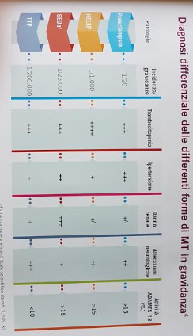
TROMBOTIC MICROANGIOPATHIES
1/20
1/1000
1/25000
1/200000
Notes:
L’ incidenza della PTT è stimata in 4 casi/milione/anno ¹
80-90% idiopatica acquisita (autoimmune)
10% ereditaria (sindrome di Upshaw-Schulman)
Mortalità
95% nei non trattati ²

Slide 24
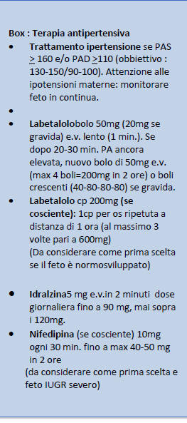
Hypertensive Emergencies
Pharmacologic Management of Acute Hypertensive Crisis

Slide 25
Long-Term Complications of Preeclampsia
PRECLAMPSIA is a multi-organ syndrome of pregnancy, with widespread Maternal Endothelial Disfunction in the presence of a relatively Underperfused Placenta.
DELIVERY of the FETOPLACENTAL UNIT remains the only cure.
But years after a pregnancy complicated by preeclampsia,
women are at increased risk of :
chronic hypertension
diabetes mellitus
ischemic heart disease
kidney disease
thromboembolism
hypothyroidism
impaired memory

Slide 26
CONCLUSION
Accurate and Rapid Diagnosis is required to promote appropriate treatment and avoid life-threatening situations
Promote Prophilaxis in Risk Cases: Low dose ASA ( ASPRE TRIAL )/LMWH
Promote PostPartum Follow-up: short term and long term
Multidisciplinary Collaboration among Obstetricians/Gynaecologists Hematologists, Neonatologists , Anaesthesiologists,Psycologists is Essential for the Management of this Syndrome

Slide 27
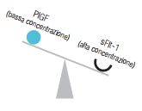
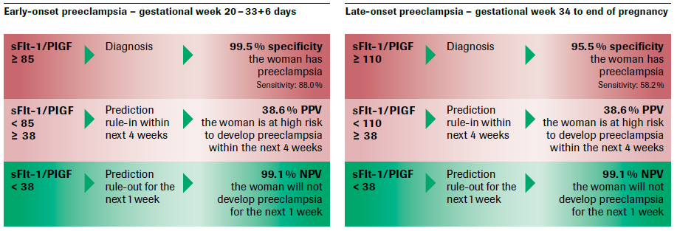
The Prognosis Study, 2016
sFlt-1/ PlGF Ratio reflects antiangiogenic imbalance
in early or late PE
PROGNOSIS Study validated the CUT-OFF values
of Elecsys sFlt-1/PlGF Ratio, predictive/diagnostic of preeclampsia
NEJM, 2016
Notes:
sFlt1 antiangiogenetico e PlGF proangiogenetico; Misurazione del biomarker dell’angiogenesi circolatoria materna come il rapporto tra sFlt-1/ PlGF riflette lo squilibrio in senso antiangiogenetico che caratterizza la preeclampsia incipiente o manifesta. Studio prognosis pubblicato sul new england journal nel 2016

Slide 28
Why Heparin Therapy?

Slide 29
I° Workshop of Foetal Medicine Group –
Parma, March 11-12, 1977
“Preliminar Studies on the Presence of Anticoagulant Activity in Human Term Placentae”
de Luca Brunori I., Moggi G., Bianchini P., Giusti G.
Fioretti P.

Slide 30
XIV° International Meeting of the
Organization Gestosis - Vienna, 1982
Mucopolisaccarides and Anticomplement Activity in Human Placentae:
“Identification of Human Heparin”
de Luca Brunori I., Moggi G., Osima B., Parma B., Bianchini P.

Slide 31
VIII° Congresso Nazionale per lo Studio dell’Emostasi e della Trombosi
Firenze, 1984
Heparin or Heparin-like Activity in Human Term Placentae from Normal, Diabetic, IUGR and Gestosic Women
Bianchini P., Tellini M., de Luca Brunori I., Moggi G., Romano I., Fioretti P.

Slide 32
Our data confirm:
the presence of Heparin fractions and other GAGs in human placenta
the decrease of this antithrombotic activity in placentae from gestosic, diabetic and IUGR pregnancies

Slide 33
The status of latent intravascular coagulation characterising thrombotic risk pregnancies (McKay 1981, Kobayashi 1987)
A role of Heparin on placental rheology
(Bianchini 1977-1980, Wasserman 1979-1980-1983)
The immunomodulating effects of heparin
(Currigan 1975; Czarnetzki 1980; Dunn 1983; West 1983; Edwards 1983; Laghi Pasini 1984)

Slide 34
The reduction of Heparin-like activity in placentae of preeclamptic, diabetic and IUGR pregnancies (de Luca Brunori 1982, Bianchini 1984)
Heparin does not cross the placental barrier, therefore its use is absolutely safe for the fetus (Goodman and Gilman 1975)

Slide 35
NEONATAL INTRACRANIAL HEMORRAGE AND MATERNAL USE OF ASPIRIN
Carol M. Rumack et Al.
Dept. of Radiology, Pediatrics and Biomedics
( Obstet Gynecol 58:52S, 1981)
FETAL INTRACRANIAL HEMORRHAGE DUE TO ANTENATAL LOW DOSE ASPIRIN
Sasidharan CK, Kutty PM, Ajithkumar, Sajith N.Indian
J Pediatr. 2001 Nov;68(11):1071-2. doi: 10.1007/BF02722359.PMID: 11770244

Slide 36
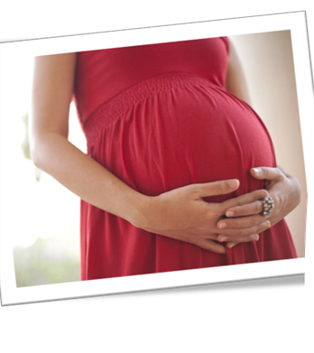
THANK YOU FOR YOUR ATTENTION

Slide 37
Saving Babies …and much more

